Slide 1

Conclusions
Info 498B – Android
Joel Ross
Spring 2016

Slide 2
What did we do?

Slide 3
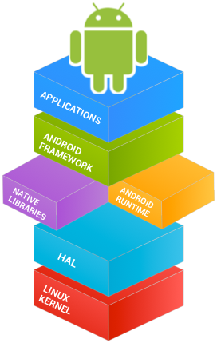
Android Framework

Slide 4
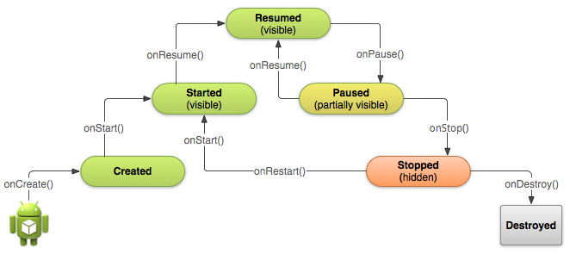
Activities

Slide 5
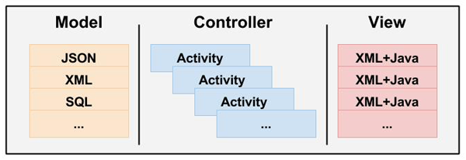
Model-View-Controller

Slide 6
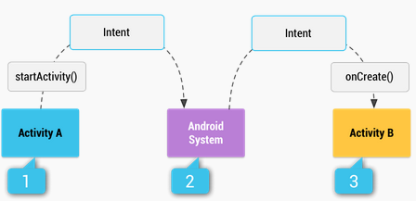
Intents

Slide 7
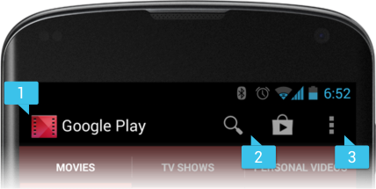
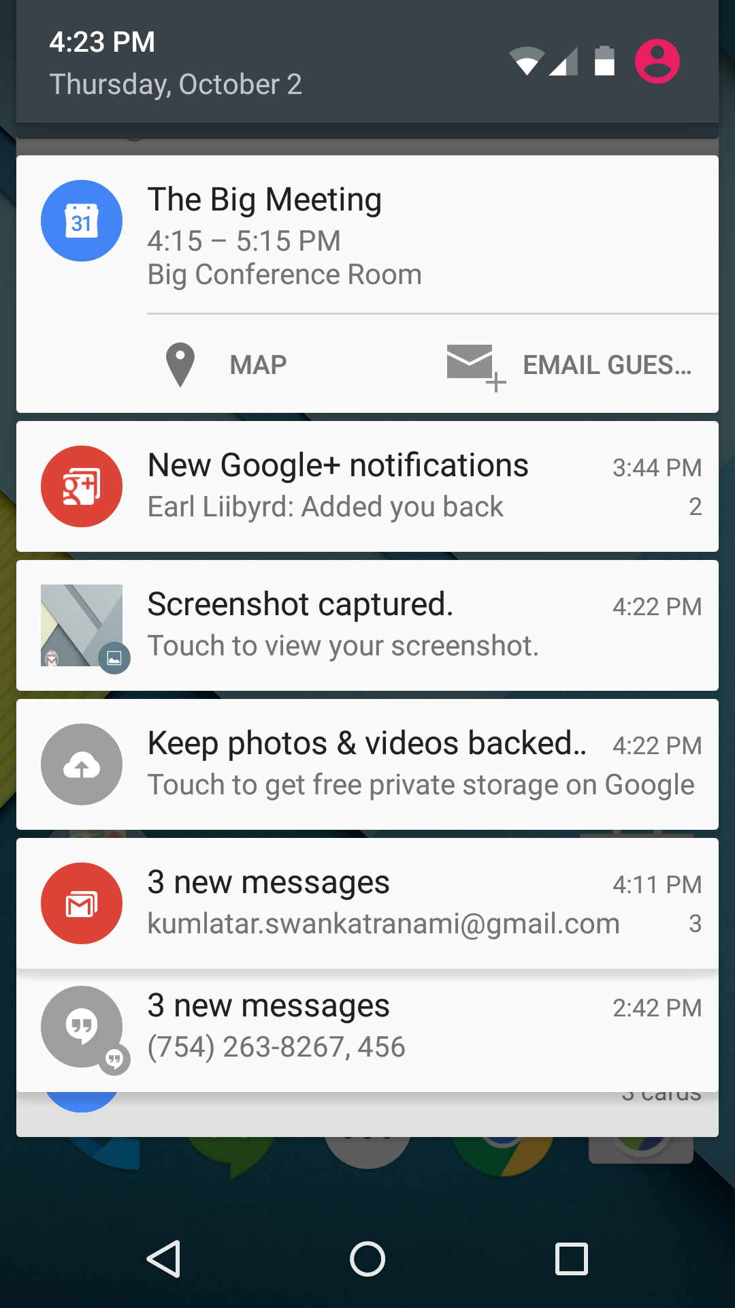
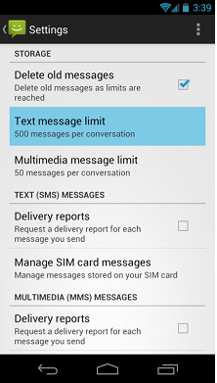
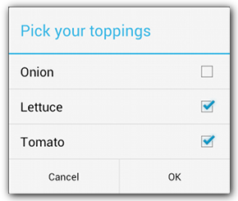
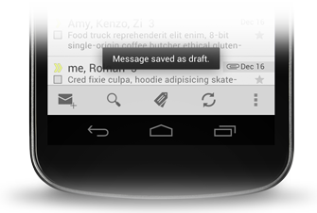
UI Widgets

Slide 8
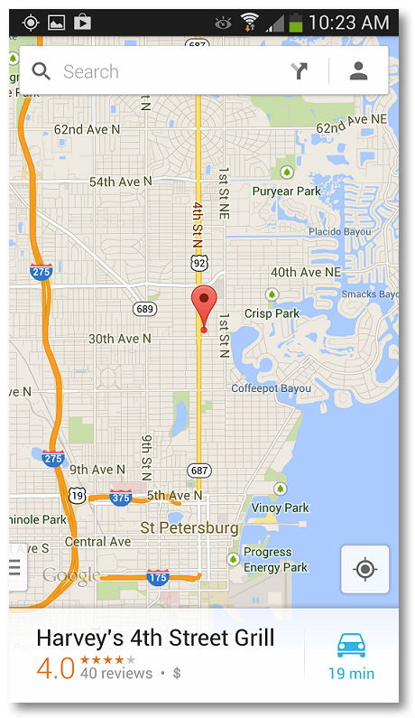
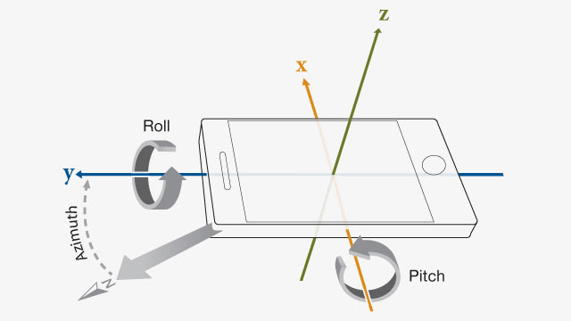
Capabilities

Slide 9
What did we not do?

Slide 10
Design
https://developer.android.com/design/ patterns/index.html

Slide 11
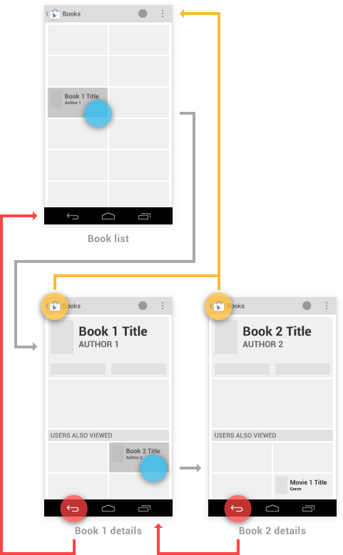
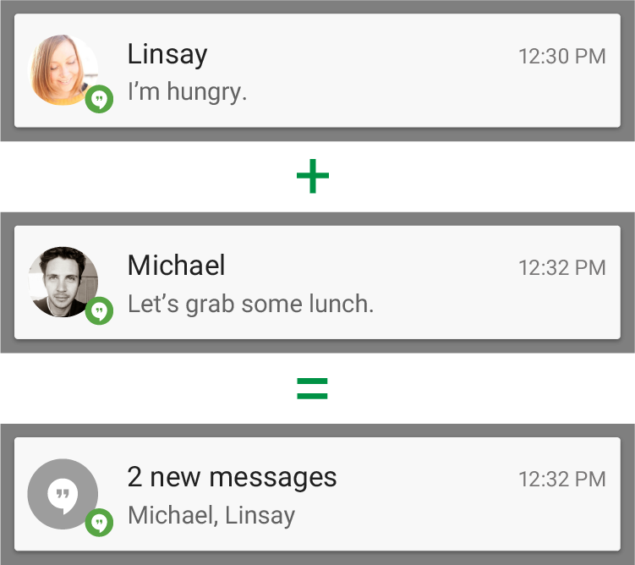
Design

Slide 12
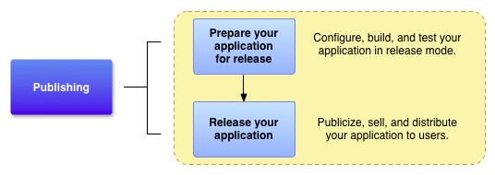
Publishing
http://developer.android.com/tools/ publishing/preparing.html

Slide 13
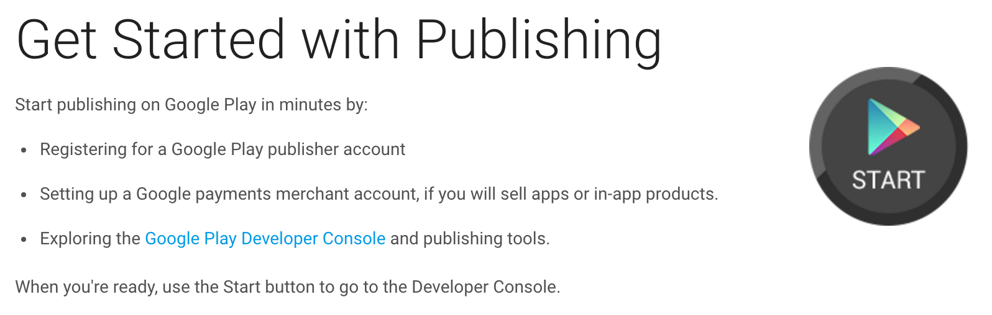
Play Store
https://developer.android.com/distribute/googleplay/start.html

Slide 14
Final Thoughts

Slide 15
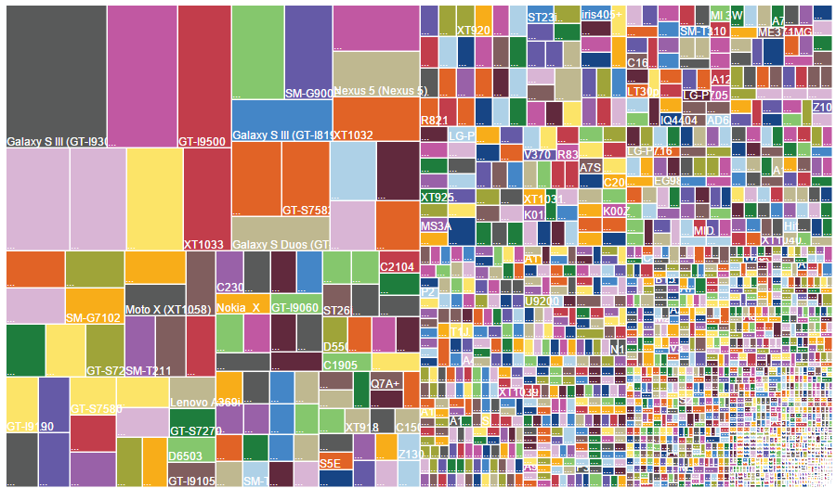
Develop for Flexibility
Android Market Share, August 2014

Slide 16

Develop for Universal Usability
source

Slide 17

Develop New Experiences!

Slide 18
Evaluations
Course Evaluation: check email!
Peer Evaluation: check email!

Slide 19
Evaluations
DO COURSE EVALS NOW!

Slide 20
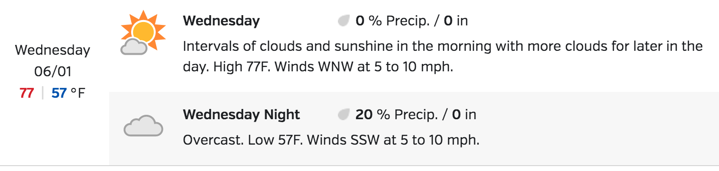
Final Presentations (Wednesday "in-class")
Projects due at start of class
Include release apk!
During normal lecture time, but outside!

Slide 21
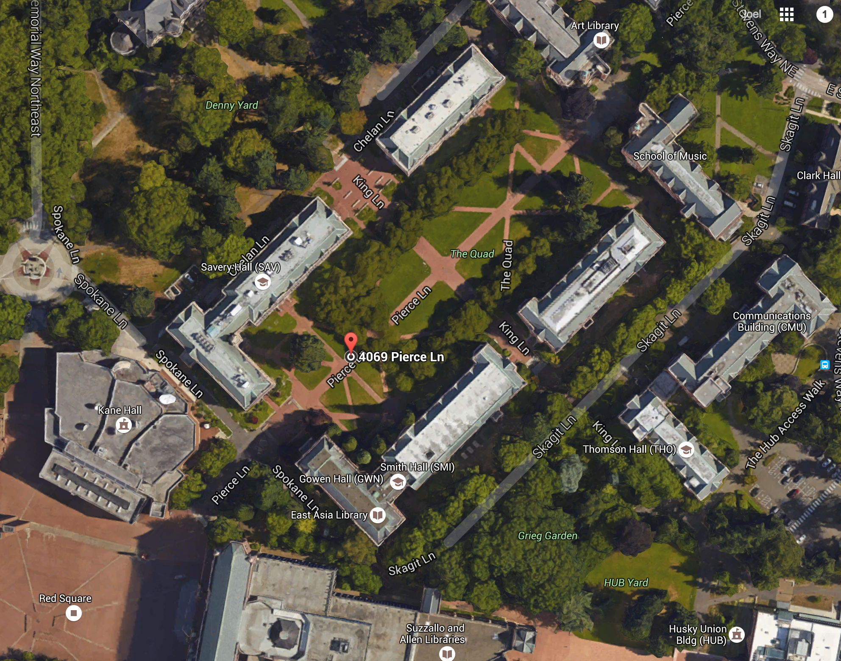

Slide 22
Final Presentations (Wednesday "in-class")
Organize into groups of 3 teams
Teams demo for each other (10min each)
Shuffle! (new groups)
Repeat
Shuffle! (new groups)
Repeat

Slide 23

Thanks for a great course!

